Slide 1
Array
TUAN NGUYEN

Slide 2
Outline
Python’s sequence type
Low-level array
Referential array
Dynamic array
Efficiency of list

Slide 3
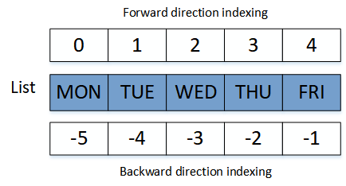
Python’s Sequence Type
Python’s various “sequence” classes: list, tuple, and str classes.
Support indexing to access individual element, seq[k]
=> array

Slide 4
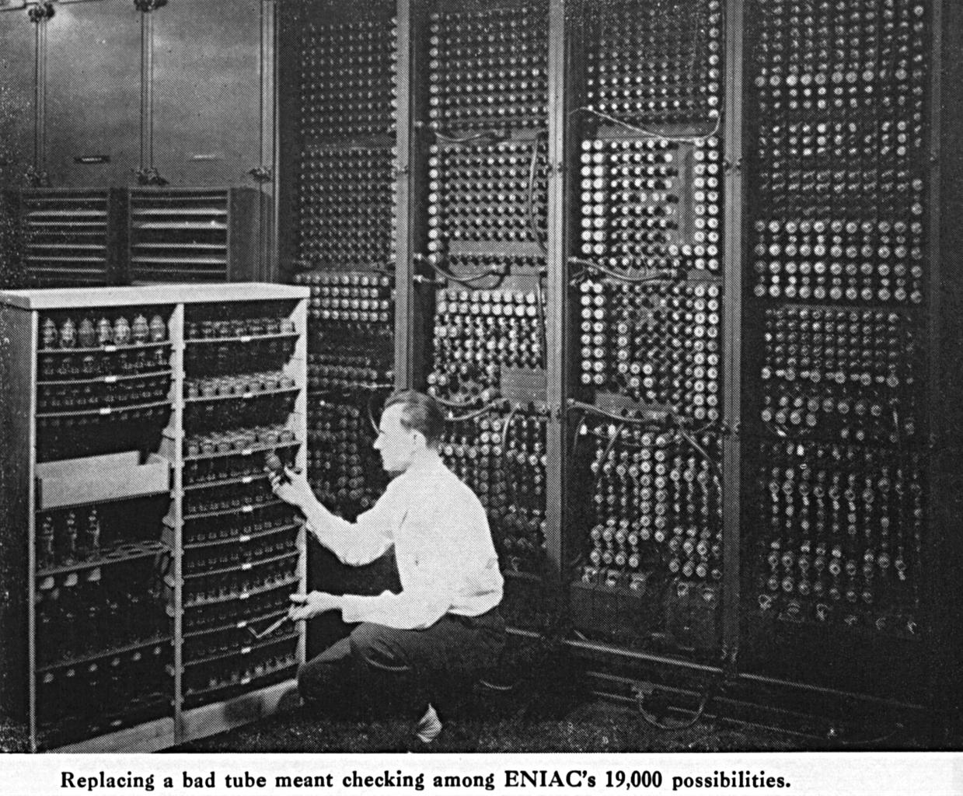
Computer
A bit is the smallest unit of computer information, yes/no, 0/1.
A byte on the other hand is a unit of memory that usually contains 8 bits. This is because historically, 8 bits are needed to encode a single character of text.
A computer system will have a huge number of bytes of memory.

Slide 5
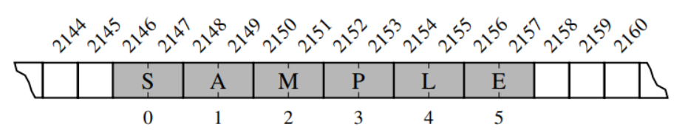
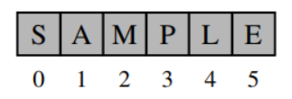
Low-Level Arrays
To keep track of what information is stored in what byte, the computer uses an abstraction known as a memory address.
The information is stored in Random Access Memory (RAM).
Python internally represents each Unicode character with 16 bits (i.e., 2 bytes)

Slide 6
Referential Arrays
Each string has different length.
How can Python to store that list?
How can we access the index of element?

Slide 7
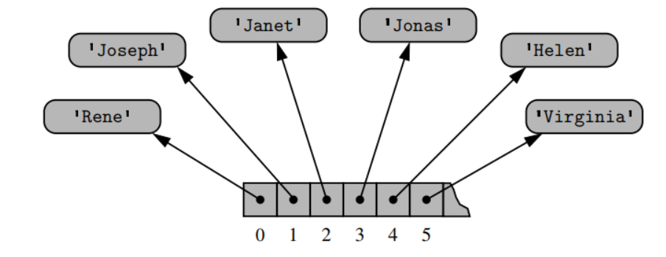
Referential Arrays (1)
Python represents a list or tuple instance using an internal storage mechanism of an array of object references.

Slide 8
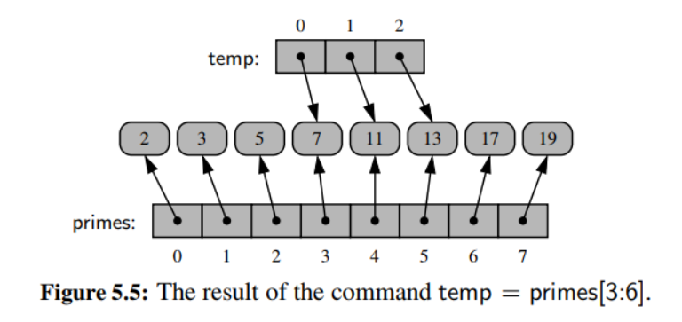
Referential Arrays (2)

Slide 9
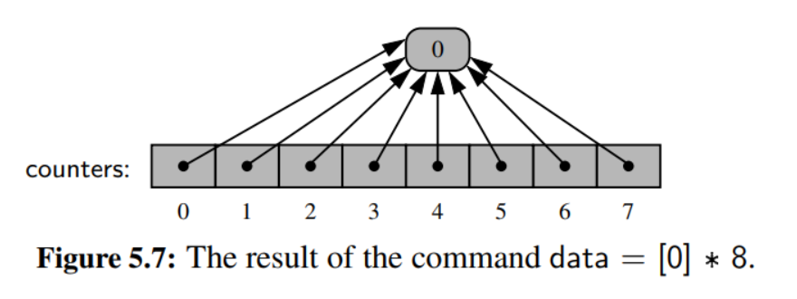
Referential Arrays (3)

Slide 10
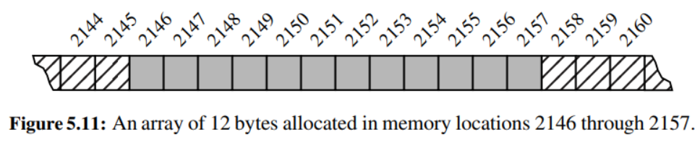
Dynamic Arrays
When creating a low-level array in a computer system, the precise size of that array must be explicitly declared for the system to properly allocate a consecutive piece of memory for its storage
However, the list allows us to add elements to the list => How?

Slide 11
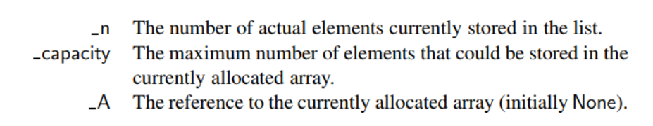
Dynamic array (1)
State information in the list

Slide 12
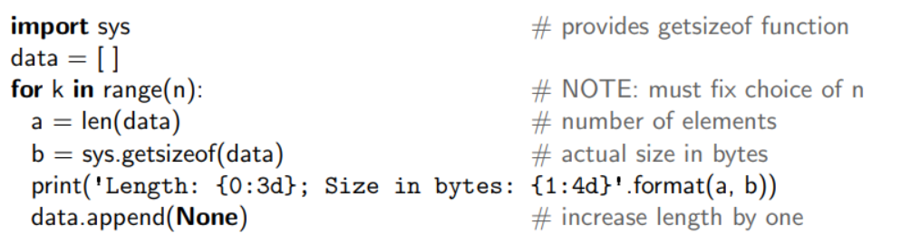
Dynamic array (2)
The list maintains the capacity higher than the length of list, length 5 -> capacity 10
Add element -> ok
If the length reaches the capacity -> allocate to new memory with higher capacity.

Slide 13
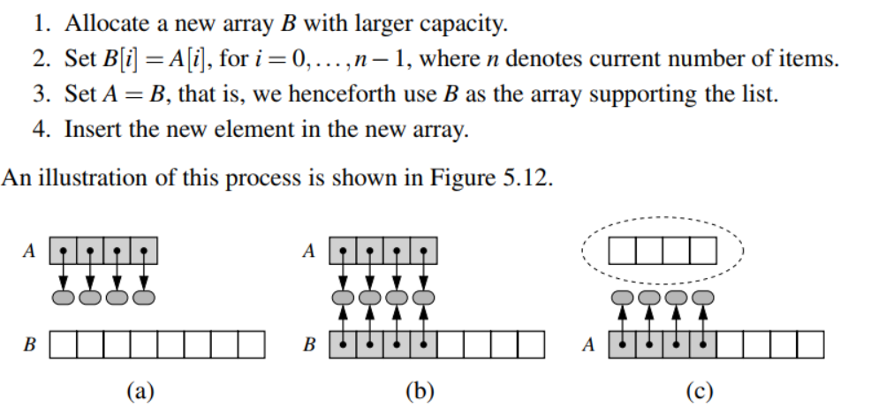
Dynamics array (3)
When capacity is full:

Slide 14
Exercise
What is the running time of adding consecutive n elements to the list? Double capacity of size of list reaches the capacity.

Slide 15
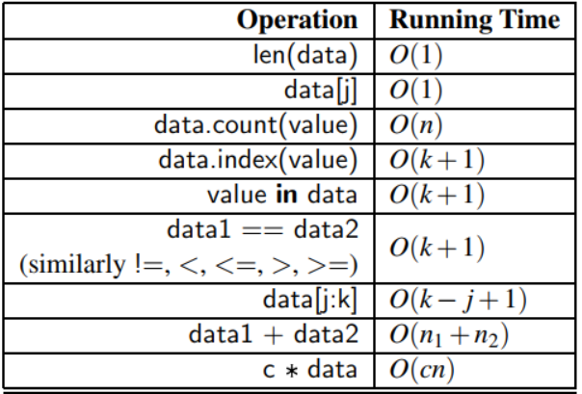
Efficiency of Python’s Sequence Types

Slide 16
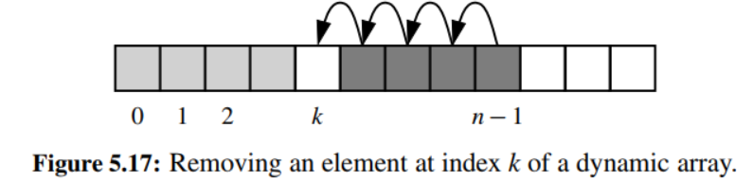
Remove elements from list
Pop()
Pop(index)
Remove(value)

Slide 17
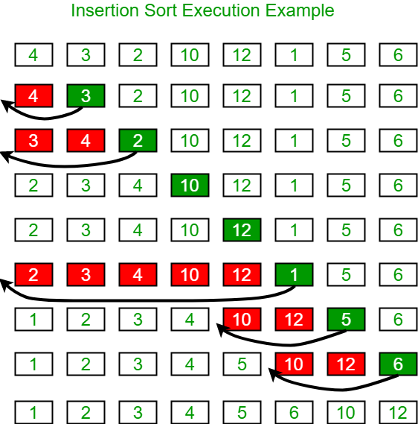
Exercise
Implement insertion sort

